Slide 1

Cyprus Agricultural Payments Organization
CAP: A member states’ perspective
Socrates Socratous
Head of the IACS Department & Authorization of Payments
11-13 September 2012
Pafos, Cyprus

Slide 2
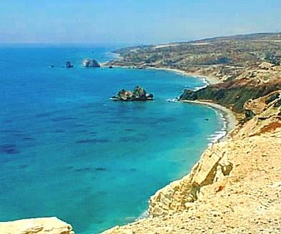
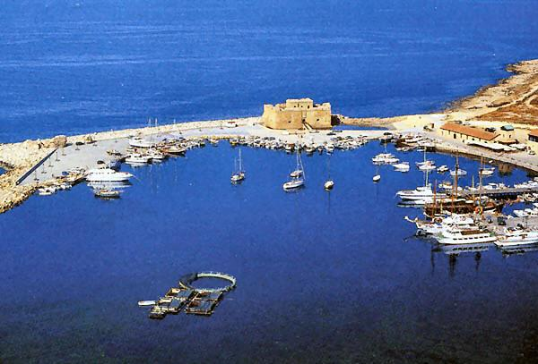
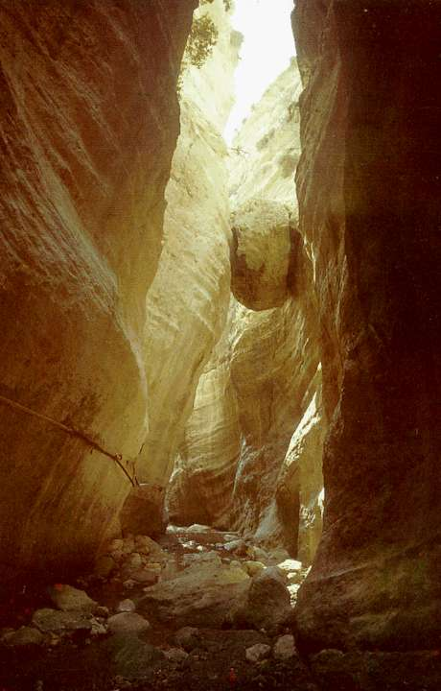

Καλωσορίσατε στην Κύπρο.
Welcome to Cyprus Tere tulemast Küpros
Benvenuti a Cipro Fáilte go dtí An Chipir
Bienvenue à Chypre Dobrodošli na Cipru
Willkommen auf Zypern Sveiki atvykę į Kiprą
Velkommen til Cypern Merħba għall Ċipru
Bienvenidos a Chipre Velkommen til Kypros
Witaj na Cyprze Welkom op Cyprus
Добре дошли в Кипър Üdvözöljük a Ciprus
Bem-vindo ao Chipre Bine ați venit în Cipru
Добродошли на Кипру Добредојдовте на Кипар
Vitajte na Cypre Dobrodošli na Cipru
Välkommen till Cypern Vítejte na Kypru
Tervetuloa Kyprokselle

Slide 3
CAP: Legislative Framework
The proposals take the form of four main legal instruments which will replace the existing regulations governing the CAP, as follows:
  A regulation governing direct payments;
  A regulation governing rural development payments;
  A regulation revising the single Common Market Organization regulation (CMO);
  A horizontal regulation covering financing, management and monitoring of the CAP

Slide 4
CAP at a glance
Direct Payments | Market Measures | Rural Development
Convergence of direct payments across MS. New basic payment to replace the SPS &SAPS New “green” component of DPs Greater targeting of beneficiaries New rules for coupled payments Changed CC rules | Confirmation of the ending of milk quotas, of sugar quotas (with one year delay), and of vine planting ban Extension of the market disturbance clause to all commodities under the CMO Measures to improve functioning of the food chain Measures to support quality production | New RD priorities to replace current axes Better coordination with other EU funds New criteria to allocate Pillar 2 funds across member states Simplification of supported measures Enhanced risk management toolkit European Innovation Partnership Proposals on monitoring and evaluation

Slide 5
DP Prevails
Market Measures->Minor changes
RD → Sustainable Management of Natural resources and to climate action
DP →73% EU CAP expenditure
MFF ↓ real terms but ↑ in nominal terms
2013→39% of EU budget 2020→33%
Pillar I → 281.8Bns, Pillar II→ 89,9bns
Additional 15.2bns. Total: 386.9bn

Slide 6
Payments Under DP
Scheme | % of NC | Voluntary
Basic payments for farmers | 43-60% | Mandatory
Greening | 30% | Mandatory
Natural Constraints Areas | Up to 5% | Voluntary
Young Farmers | Up to 2% | Mandatory
Small Farmers | Up to 10% | Mandatory
Couple Support | Up to 5/10/+% | Voluntary
Complementary Nat DP for Bulgaria & Romania Specific Payment for Cotton Posei, Aegean islands

Slide 7
Greening
Practice | When | DO | Exceptions | Notes
Crops Diversification | Claimed Arable Land>3 hec | 3 crops. None < 5% of Arable Land and none >than 70%. | 1. Entirely for Grass Production 2. Left fallow 3. Crop under water
Permanent Pasture | Permanent Pasture claimed Land | Maintain for ever 2014=Reference | 5% of Reference land
EFA | Claim EFA | 7% of the Eligible Area excluding areas under Permanent Grassland |  | Land left fallow Terraces Landscape features Buffer Strips Afforested Areas
Payment to those observing the practices relevant to them, participating to organic farming, whose holding fully or partly in areas defined as Natura 2000.

Slide 8
MS-Gr(1)
Yes to the Gr but introduce amendments
Pluses:
  Organic farmers would automatically receive the GrP as well as Natura 2000 farmers.
  Ineligible land might count towards EFA obligation, which could be of real value to some farmers and take account of their biodiversity
  Suggestion: Extend exemptions for Greening
    AEM participants, harder GAEC baseline req.
Skeptic:
  30% of the whole DP financial envelop → 85billions.
  Cost of greening: €33 / hec leading to 4.8% fall in farm income.
  compliance and penalties might also apply to the BPS = great disincentive. More clarification for penalty regime of breaching Gr.
  Suggestion: Reduce 30% to 20% or even to 10%.
  Real voluntary with out penalty effects on other schemes
  Instead of Greening extend CC

Slide 9
MS-Gr(2)
  One size does not fit all – Menu like approach
  Greening → Premature remove of permanent crops
  Suggestion: Further Gr measures identifying “win/wins” should be added to the list of measures.
  Diversification (the three crops rule) to cover the arable area of a farm and EFA (7% of eligible land rule) will be difficult both to implement at farm level and to control at administrative level
  Suggestion: 3 crops for diversification → 2 crops, main crop not more than 90%, 2 main crops <95%
  Increase the 3 hec threshold for diversification to 5 /10 hec or even to the average size of agri holding per MS (AnnexVI).

Slide 10
MS-Gr(3)
  7% EFA requirement is too big and removes crop production and lessens the farm income accordingly
  Suggestion: Lower the 7% EFA req.
  Except livestock units growing their own feed from EFA.
  Except those with eligible land less than 5/10 hec.
  Permanent Pasture. Definition needs more clarification
  Suggestion: More details on the definition, 75% of eligible land Permanent Pasture ➔ Only Permanent Pasture practice.

Slide 11
MS-Gr(4)
Implementation Difficulties
  Crop Diversification
    Definition of 3 different crops should be clarified.
    Farmer difficulties to learn and manipulate %.
    Adding parts and pieces to accumulate the 5% crop requirement
  EFA:
    7% threshold excluding permanent grassland becomes very small in applicants with less than 0,5he→350m² creating high LPIS and On spot impact. Multiple Layers on LPIS.
    Introduces complexity and high level of admin.cost

Slide 12
MS-Gr(5)
    EFA definition lacks clarity.
    Buffer strips → a source of controversy. Who owns
    New layer in LPIS. Administration cost to be updated and maintained. Controls become more complex and difficult. Dispute with farmers.
Increasing the ambition of agri-environmental measures in RD Programs in Pillar 2, combined with strengthened cross compliance standards, could offer more effective environmental protection at a lower cost in terms of forgone food production [Alan Matthews, Department of Economics, Duplin University]. and farming income

Slide 13
Small Farmers Scheme–SFS(1)
Payments under the SFS shall replace the payments to be granted on BPS and VCS.
Farmers participating in the SFS shall be exempted from the Gr.
Farmers wishing to participate in the SFS shall submit an application by 15.10.2014
Farmers not having applied for participation in the SFS 15.10.2014 shall no longer have the right to participate in that scheme.

Slide 14
Small Farmers Scheme–SFS(2)
Amount of Payment= either an amount not exceeding 15 % of the national average payment per beneficiary (NApB).OR. an amount corresponding to the national average payment per hectare (NApH) multiplied by a figure corresponding to the number of hectares with a max. of 3.
NApB= National Ceiling for 2019 / Number of farmers obtained entitlements.
NApH= National Ceiling for 2019 / Number of eligible hectares declared in 2014.

Slide 15
Small Farmers Scheme–SFS(3)
If Payment<(>)€500,(€1000) ➔ Payment =€500, (€1000). CY,MA→€200.
During the participation in the SFS, farmers shall: a) keep at least a number of hectares corresponding to the number of entitlements held; b) eligible area not less than 1 hec (adjusted Annex IV).
Farmers who by way of inheritance receive PEs from a farmer participating in the SFS shall be eligible for participation in that scheme provided they meet the requirements to benefit from the BPS and that they inherit all the PEs held by the farmer from whom they receive the PEs.

Slide 16
MS- SFS(1)
Pluses
  Very helpful scheme with minimum administration.
  A scheme towards Simplification
Voices against:
  More suitable for MS with small farmers and not beneficial to big farmers countries
  “Pony paddock payment” paid to not farmers
  Reduce the legitimacy of the CAP support in the eyes of EU taxpayers.
  Art 51 imposes linear reduction not in favor to “real farmers”.

Slide 17
MS- SFS(2)
Improvements suggested
  Turn it to volunteer
  When MS circumstances justify it (especially for SF_MS), increase the threshold of 10% allocated to SFS.
  Introduce a kind of min. agricultural activity req. for these farmers instead of “nothing”.
  The CC paradox should be settled

Slide 18
MS- SFS(3)
Implementation Difficulties
  Art47 §4: No Payment when holding is divided
    Very hard to establish unambiguously this event
    From which date (specify).
  Art48: Another application by 15.10.2014!
  Art50§3: SF Entitlements Not transferable.
    When the land sold and return to BPS why not transferring the Ents as well.
    Complexity through the need of maintaining another kind of entity under the Ent category.

Slide 19
Young Farmers - MS
Payments to YF mandatory to MS.Optional to Farmers
  YF: Under 40 years old .AND. Who is setting up for the first time an agricultural holding or who have already set up such a holding during the 5 years preceding the first application. AND. Is the head of the holding
  Art36:MS shall grant an annual p/mnt to YF…
    Real problem not the subsidy but capital → RD
    Shall → Can
  Difficulties: date and head of the holding and more determining the 5 years preceding the appl
    Solution: No DP for the last 5 years.
    Abolish the requirement for the head of the holding

Slide 20
NCA - Active Farmer
NCA funding from both DP&RD→ Remove it from DP.
Active Farmer
  DP < 5% (Total Receipts-Rec.from Agr.)
    How to verify that? Tax information is needed.
    Receipts from Agriculture sometimes very difficult to be found and defined
    Some businesses with significant agricultural activity because successfully diversified (tourism, banking, investment, etc) their activities would fail the test.
Active Farmer→ Revise fundamentally.

Slide 21
Capping
Capping of payments
  Art11§1: 20% →100% from €150K-€300Κ DP⁻
    Disincentive to achieve economies of scales
    Disproportionately affect larger farmers who over time have consolidated to become more efficient
  Art11§2: DP⁻ = DP-Gross salaries-GrP.
    Gross Salaries → Difficult to calculated
    Contract Labor, Business Owner Labor?
Art11§3: Circumvention clause –> No Payments to those artificially created the conditions to avoid the effects of the Capping
    Who and on which ground decides the artificially

Slide 22
Capping (2)
      Many changes might occur in a farm business. Who has the burden to prove that these changes are genuine or artificial?
      It does not encourage business to take advantage of business structure efficiency improvement opportunities
  Mitigation options for Capping:
      Instead of gross salaries deduct predefined amounts dependent on the size of the holding
      Abolish capping or put higher threshold (on threshold is still an option)
      No deductions and increase scales thresholds
      Abolish Circumvention clause

Slide 23
Capping (3)
Implementation Difficulties
  Collect Labor Expenses
    Crosscheck with MS’s Competent Authorities
    Communication Link – Info. Availability?
    Capping only a few farmers, collect the capping amount to be exploited in another measure
  Introduces complexity on S/W systems and administration cost.
  Make Capping voluntary for MS

Slide 24
Modulation – CS.
National Modulation
  Art14§1: MS may decide (01.08.2013) to transfer up to 10% of NC to EAFRD
  Art14§2:Specific MS may decide (01.08.2013) to transfer up to 5% of EAFRD to DP.
    It could be extremely distorting. Better the budgets for Pillar I and II been defined by the outset to prevent market distortion trends.
Couple support
  Art39: VCS may be 5% or 10% or even higher
    This create a Market Distortion trend. Thus limit it to 5% or even smaller.

Slide 25
DP=15% Additional Administrative Cost.
Change Management, Mind the Changes.

Slide 26
RD
Yes to axes removal.
The creation of a European Innovation Partnership is also welcome.
Extend Risk Management and remove it from Pillar II
Shorter commitment periods. Legalize the recital which allocates 25% EAFRD to AES
LFA reclassification: The introduced flexibility is welcomed and ask for more: The area covered per administrative unit instead of 66% of UAA decrease it to 50%.Allow combination of natural constraint factors to satisfy the 66% coverage.
Abolish the Overlaps of EAFRD with DPs = Simplicity.

Slide 27
Single CMO
Sugar regime – a majority of member states oppose the end of this regime and would like it extended. Transition of 5 years.
Producer organizations – a majority of MS opposed the proposed obligatory recognition of these organizations in all sectors, suggesting making this optional for MS.
Safety nets - A number of MS would like to introduce a mechanism to update the level of reference prices. Some MS call for the phasing out of export refunds irrespective of the outcome of WTO talks, whilst others maintain they should remain for as long as the EU’s international obligations allow so.

Slide 28
HRZ
Art76 HRZ: Payments under IACS shall be made within the period from 01.12-30.06 of the following calendar year.
  Not allowed any more the use of N+2 reg. for AEM. Change to at least N+1 for AEM.
Cross compliance : Remove the Water framework directive from CC. Some MS are opposed to the future inclusion of the Sustainable Use of pesticides directive.

Slide 29
IACS (1)
Each MS shall set up and operate an IACS that shall apply to:
  BPS, Gr., NCA., YFS, VCS, Cotton, SFS, Posei, Agean Islands.
  Supports for “afforestation and creation of woodland”, establishment of agro-forestry systems, Agri-environmental-climate measure, Organic farming measure, Natura 2000 and Water framework directive payments measure, Measure for areas facing natural or other specific constraints, Animal welfare measure, Forest-environmental and climate services and forest conservation. [Ar68-628].

Slide 30
IACS (2)
Elements of IACS:
DBs (Applicants, Parcels, Ents, Applications, etc.)
LPIS for parcel identification
S/W Modules:
1. Web-GIS for Ents application (2014) and for the yearly applications,
2. Web-Entitlement for transferring entitlements (banking system) and entitlement information and for Entitlement activation
3. Control System for registering and processing on the spot and remote sensing control results
4. Cross Compliance System

Slide 31
IACS (3)
5. Application Processing System (administrative controls, application processing, calculation of eligible / payment areas per parcel, calculation of penalties, reductions and sanctions, Payments (Dapf, Naf), Recoveries, etc).
Sub-systems: BPS, YFS, GrP, PfNCA, VCS, SFS, Cotton, etc.
6. Security sub-system, user administration, rights & privileges
7. Information Tracking Changes and auditing
system (historical data, who / when / which / where)
8. Reporting and data mining tools.

Slide 32
IACS abstract design
ComLinks
Web-GIS
Claims
LPIS
Control
System
Web-Ent
GIS
DB
Applicants
Parcels
Claims
Entitle-
ments
ComLinks
BPS
YFS
Green
NCA
VCS
SFS
Cotton
Agean
Etc
NC
Mgnt
ΑΕΜ
Security System – Data Change Tracking – Reporting Tools

Slide 33
Timeframe – No Time Left
According to estimation MS need 12-18 months to adjust or develop their systems to the new CAP.
Time Left until 01.2014 → 16 months
Regulations not yet final
  MEPs lodged 7,000 amendments
  Sanctions and penalties System has not yet defined
  Implementing regulations not even in draft form
  30.05.2012 amendment report for the proposed regulation consisting of 71 pages and 110 amendments!
At least a year extension otherwise nightmare.

Slide 34
In two words
DPs needs simplification
Avoid duplication of measures on Pillar I and II
Reduce the Greening Cost both for farmers and MS authorities
Decouple Gr Sanctions from other Schemes
Make DPs various provisions volunteer to MS
AEM need more time to be paid. Mind 2014.
A year extension and gradual CAP implementation is a necessity.

Slide 35
Thank you
Takk skal du ha
dank u
Köszönöm
Dziękuję
Obrigado
Mulțumesc
Хвала
ви благодариме
Ďakujem
Hvala
Tack
Děkuji
kiitos
Grazzi
Благодаря
Merci
Danke
Tak
Aitäh
Go raibh maith agat
Þakka þér
¡gracias
Grazie
Hvala
Paldies
Ačiū
Ευχαριστώ

